Slide 1
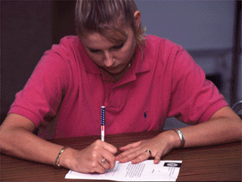



Session 23
Curriculum Vitae
Preparation and Maintenance

Slide 2
Learning Objectives
  Describe and discuss purpose of a curriculum vitae
  Identify elements of a curriculum vitae
  Prepare basic curriculum vitae
  Update and maintain curriculum vitae

Slide 3
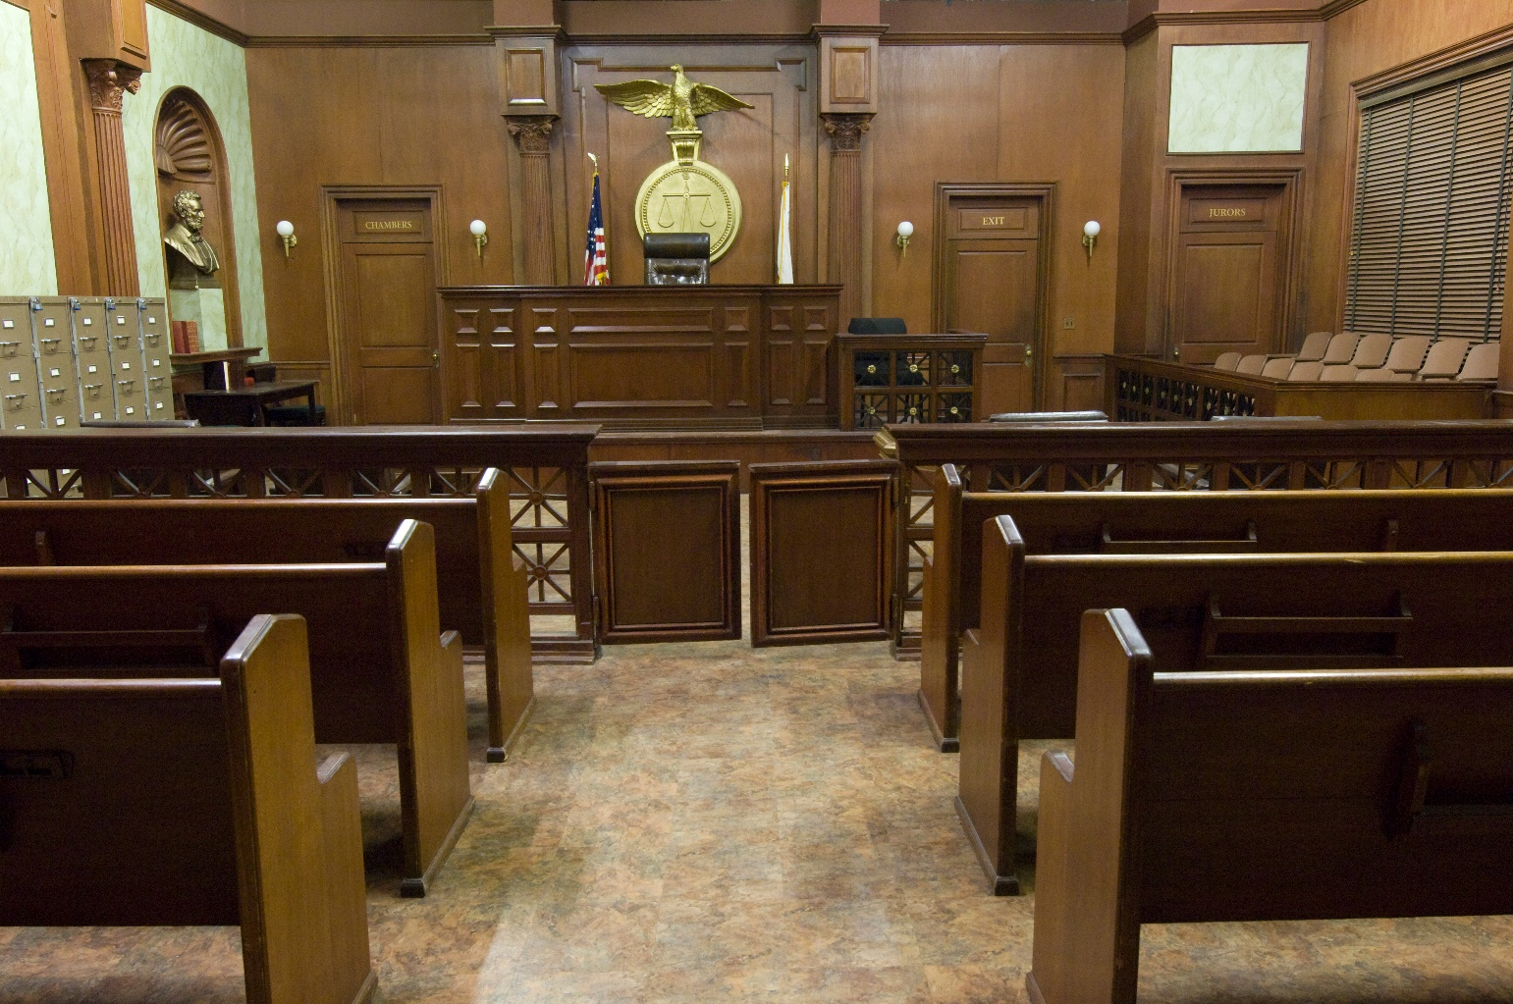
Preparation for Court Qualification

Slide 4
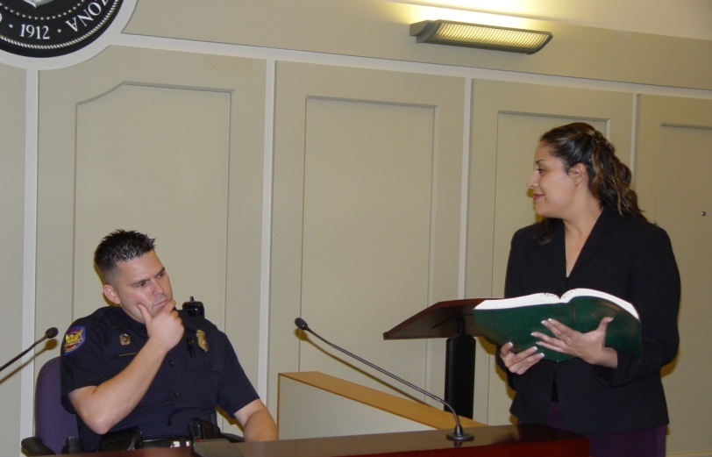
Lay Witness

Slide 5

Expert Witness

Slide 6

Curriculum Vitae Content
  Formal Education
  Formal Training
  Experience
  Prior Testimony
  Outside Reading Studies
  Training or Research Conducted
  Published Works

Slide 7
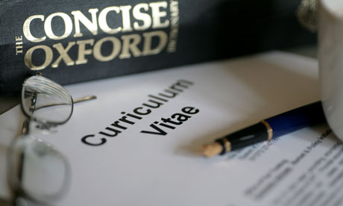
Curriculum Vitae Preparation and Maintenance

Slide 8
Questions?

